Slide 1
IBM University Engagement Project Submission
“Exploring the Power of Agentic AI with IBM Granite and LangFlow”

Slide 2
Project Title – [Smart IoT Device Troubleshooting Chatbot]
Domain of Project – [Artificial Intelligence (AI) | Internet of Things (IoT) | Conversational AI | Retrieval-Augmented Generation (RAG)]
Student Name | Recent Passport Photo | Email ID | Mobile number [WhatsApp]
Pranjal Hingmire |  | pranjalhingmire@gmail.com | 7498730874
Recommended font style and size: Font Style: Arial Font Size (Heading): 28
Font Size (Content): 20

Slide 3
Problem Statement - Smart IoT Device Troubleshooting Chatbot
The Challenge
IoT devices are widely used in smart homes, industries, and connected environments. However, users frequently encounter problems such as connectivity failures, configuration errors, firmware issues, and device compatibility challenges. Troubleshooting these problems often requires technical knowledge and the ability to interpret complex documentation. Many users depend on manuals, forums, or customer support, which can delay issue resolution. The challenge is to develop an intelligent assistant that can quickly diagnose IoT device problems and guide users through troubleshooting steps. The Objective Build a conversational AI chatbot that helps users identify and resolve IoT device issues through natural language interaction. The solution should: 1. Understand Device Issues :- Interpret user descriptions of IoT problems such as network connectivity failures, configuration errors, or device malfunctions. 2. Retrieve Relevant Knowledge :- Access IoT documentation and troubleshooting guides using a Retrieval-Augmented Generation (RAG) approach. 3. Provide Step-by-Step Solutions :- Generate clear instructions for resolving connectivity, configuration, or firmware issues. 4. Conversational Support :- Offer an interactive chatbot interface where users can ask questions and receive guidance in real time.

Slide 4
Proposed Solution -
Develop an AI-powered Smart IoT Device Troubleshooting Chatbot that understands user-reported issues through natural language, retrieves relevant troubleshooting information using a Retrieval-Augmented Generation (RAG) approach, and provides clear, step-by-step solutions. The chatbot offers real-time conversational assistance, enabling users to diagnose and resolve IoT device problems quickly and efficiently without requiring advanced technical knowledge.
The system uses:
Natural Language Processing (NLP) to understand user-reported problems.
Retrieval-Augmented Generation (RAG) to retrieve relevant troubleshooting information from manuals, FAQs, and knowledge bases.
AI-based reasoning to provide accurate, step-by-step solutions.
The chatbot delivers instant and interactive support, reducing troubleshooting time, minimizing dependence on technical experts, and improving the reliability and usability of IoT devices.

Slide 5
Technology Used
Software & AI Technologies
Python
Natural Language Processing (NLP)
Retrieval-Augmented Generation (RAG)
Large Language Models (LLMs)
Frameworks & Libraries
LangChain
Sentence Transformers
Hugging Face Transformers
Streamlit / Flask for chatbot interface
Database & Knowledge Base
Vector Database (FAISS or ChromaDB)
Device manuals, FAQs, and troubleshooting documents
Cloud & Communication
MQTT Protocol
REST APIs
Cloud Platform (AWS, Azure, or Google Cloud)

Slide 6
Langflow component Used -
Langflow Components Used
1) Chat Input
Interface where users describe IoT device issues such as connectivity failures, configuration errors, firmware update problems, or compatibility issues using natural language.
2) IBM watsonx AI Agent
Processes user queries, understands the reported problem, and coordinates the troubleshooting workflow using AI reasoning and knowledge retrieval.
3) IBM Granite Model
Granite-4.0-8B-Instruct → Generates accurate and context-aware troubleshooting responses and provides real-time step-by-step guidance for resolving IoT device issues.
4) Chat Output
Displays AI-generated troubleshooting instructions, diagnostic recommendations, configuration steps, and possible solutions to the user.
5) File Component
Stores and retrieves IoT device manuals, troubleshooting guides, FAQs, firmware documentation, and historical issue logs used by the RAG pipeline.
6) Vector Store (FAISS / ChromaDB)
Converts and stores document embeddings to enable fast and relevant retrieval of troubleshooting information during user interactions.
7) Embedding Model
Transforms device manuals and support documents into vector embeddings for semantic search and efficient knowledge retrieval.
8) RAG Pipeline Component
Combines retrieved troubleshooting information with the AI model to generate accurate, context-aware, and explainable responses.

Slide 7

Role of Agentic AI in the solution
Chatbot
Agentic AI enables the Smart IoT Device Troubleshooting Chatbot to function as an intelligent, autonomous support system rather than a simple question-answer chatbot. Using IBM watsonx.ai and IBM Granite models, it coordinates multiple specialized agents to diagnose and resolve IoT device issues efficiently.
Each agent performs a specific task, such as understanding user-reported problems, retrieving relevant troubleshooting information, analyzing device logs and error messages, identifying possible root causes, and generating step-by-step solutions. These agents work collaboratively to provide accurate and effective assistance.
Agentic AI also provides context awareness by understanding details such as device type, firmware version, network status, and previous troubleshooting attempts communicate with each other to improve decision-making and ensure comprehensive problem resolution.

Slide 8
Novelty and Uniqueness
Combines Artificial Intelligence, IoT, Natural Language Processing (NLP), and Retrieval-Augmented Generation (RAG) into a single intelligent troubleshooting platform.
Uses Agentic AI architecture to autonomously analyze issues, retrieve relevant knowledge, and provide personalized troubleshooting guidance.
Enables users to interact using natural language, eliminating the need for technical expertise or manual troubleshooting.
Provides context-aware recommendations based on device type, firmware version, network status, and error symptoms.
Supports troubleshooting across multiple IoT devices and manufacturers, unlike traditional vendor-specific support systems.
Uses RAG-based knowledge retrieval from manuals, FAQs, and technical documentation to ensure accurate and up-to-date solutions.
Offers real-time conversational assistance, significantly reducing device downtime and support dependency.

Slide 9
Git Hub Link
·
·
·

Slide 10
Future Scope
Future Scope
1. Integration with Real-Time Device Monitoring
The system can be integrated with IoT devices to collect real-time diagnostic information such as network status, sensor readings, error logs, battery levels, and device health metrics. This will enable the chatbot to proactively detect issues and provide more accurate troubleshooting recommendations.
2. Predictive Maintenance using AI
By analyzing historical device data and usage patterns, the system can predict potential failures before they occur and notify users to perform preventive maintenance, reducing downtime and improving reliability.
3. Voice Assistant and Multilingual Support
Adding voice interaction and support for multiple languages will make the chatbot more accessible and user-friendly. Users will be able to report issues and receive troubleshooting guidance in their preferred language.
·
·
·

Slide 11
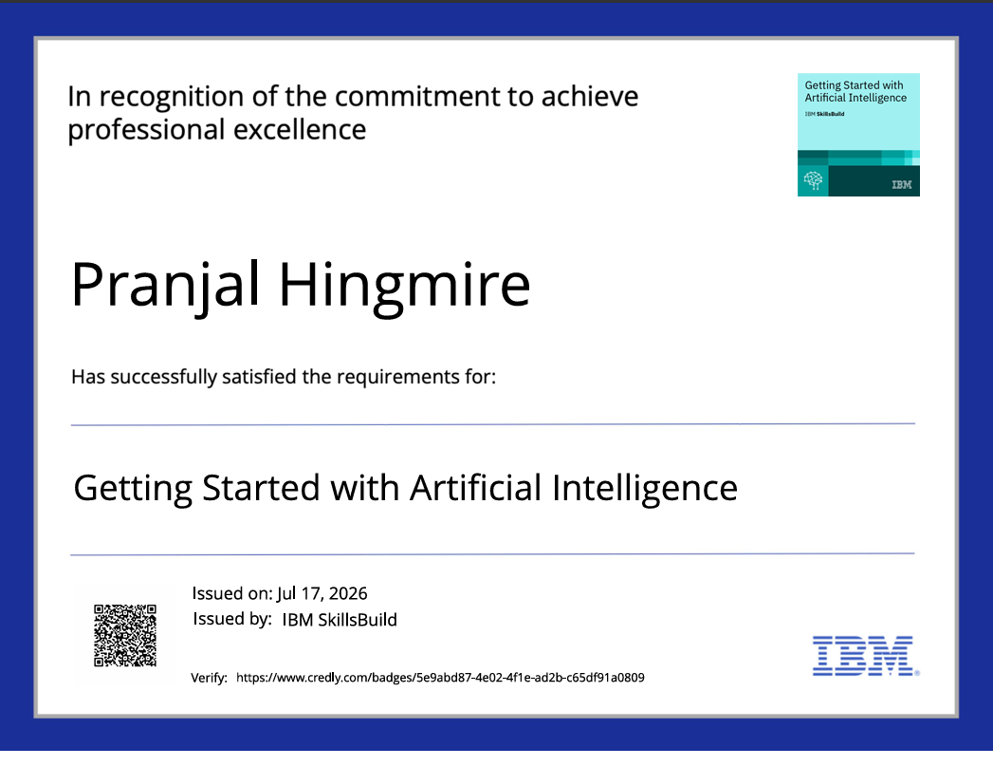
Certificates Earned:
Please add your credly certificate

Slide 12
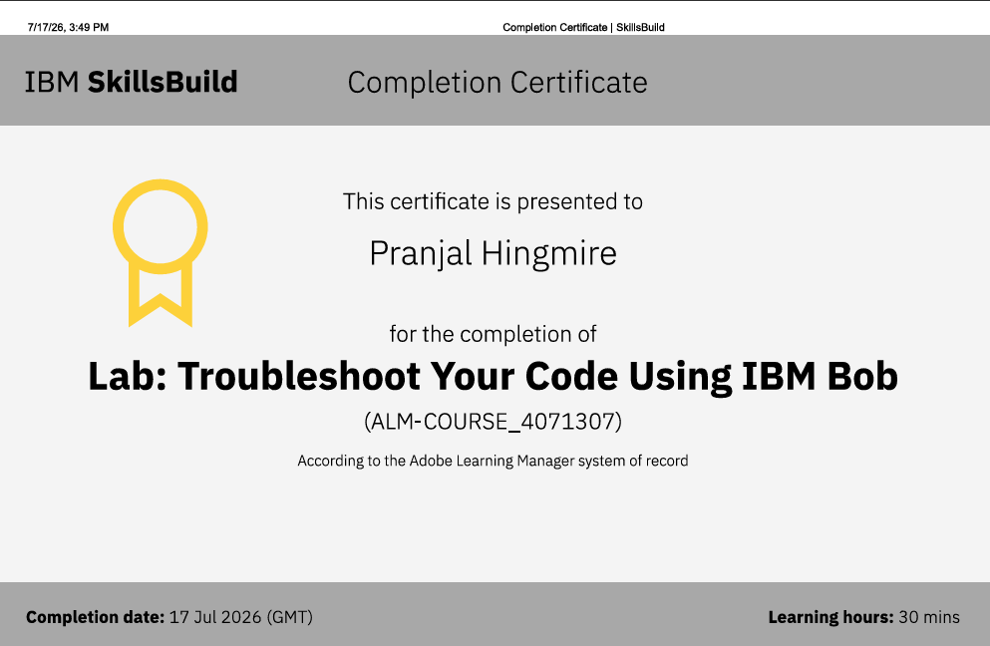
Certificates Earned:​
Add your IBM BOB Certificate

Slide 13


